Slide 1
Migrate and modernize case for Linux and OSS DB to Azure

Slide 2
Creating accessible content
Take the following steps to create accessible content that everyone can consume effectively.
Contrast
Use high contrast colors for maximum readability
The recommended contrast ratio is at least 4.5:1
Color Contrast Analyzer
Download this tool to determine the legibility of text and the contrast of visual elements
Shape and color
Use different shapes with a legend to indicate statuses to accommodate for color blindness
Example:
Alt text
Alt text helps people with screen readers understand the content of slides
You can create alternative text for shapes, pictures, charts, tables, SmartArt graphics, or other objects
Here’s how:
Right click the image or shape
Select Format Picture… or Format Shape…
Select the Size & Properties icon
Expand the Alt Text field
Enter a Title and Description of your image or object
Slide layouts
Using a built-in slide layout that matches your content ensures a hierarchical reading order of text blocks
Example:
If a new slide will have a title, rather than starting with a blank layout and adding a text block for the title, choose one of the built-in layouts with a title placeholder
Reading order
Screen readers describe content on the screen in the order it was created
To ensure your content is read back in the order you prefer, arrange your objects in the Selection Pane appropriately. Objects on the bottom of the selection pane are read first
Here’s how:
Click the Home tab
In the Drawing group, select the Arrange drop-down menu
Click Selection Pane…
Text
Text
Text
Subject 1
Subject 2
Subject 3
Download
C1
C2
C3
Additional tips!
Be sure to run the Accessibility Checker! Go to File click the Check for Issues drop down menu click Check Accessibility
Videos need to be accessible: If your presentation includes a video, ensure it is captioned and audio described (if appropriate)
Visit the Office Accessibility Center to learn more about accessibility in PowerPoint

Slide 3
Abstract and learning objectives
Abstract and learning objectives
Text here

Slide 4
Step 1: Review the customer case study
Outcome
Analyze your customer needs.
Timeframe
15 minutes

Slide 5
Customer situation
Main topic 1: size 36pt
Size 28pt for second level
Size 24pt for third level
Size 22pt for fourth level
Size 22pt for fifth level

Slide 6
Customer needs
Main topic 1: size 36pt
Size 28pt for second level
Size 24pt for third level
Size 22pt for fourth level
Size 22pt for fifth level

Slide 7
Customer objections
Main topic 1: size 36pt
Size 28pt for second level
Size 24pt for third level
Size 22pt for fourth level
Size 22pt for fifth level

Slide 8
Common scenarios
Main topic 1: size 36pt
Size 28pt for second level
Size 24pt for third level
Size 22pt for fourth level
Size 22pt for fifth level

Slide 9
Step 2: Design the solution
Outcome
Design a solution and prepare to present the solution to the target customer audience in a 15-minute chalk-talk format.
Timeframe
60 minutes
Business needs (10 minutes) | Respond to questions outlined in your guide and be prepared to present your solutions to others.
Design (35 minutes) | Design a solution for as many of the stated requirements as time allows.
Prepare (15 minutes) | Identify any customer needs that are not addressed with the proposed solution. Identify the benefits of your solution. Determine how you will respond to the customer’s objections. Prepare for a 15-minute presentation to the customer.

Slide 10
Step 3: Present the solution
Outcome
Present a solution to the target customer in a 15-minute chalk-talk format.
Timeframe
30 minutes (15 minutes for each team to present and receive feedback)
Directions
Pair with another team.
One group is the Microsoft team and the other is the customer.
The Microsoft team presents their proposed solution to the customer.
The customer asks one of the objections from the list of objections in the case study.
The Microsoft team responds to the objection.
The customer team gives feedback to the Microsoft team.
Switch roles and repeat Steps 2-6.

Slide 11
Wrap-up
Outcome
Identify the preferred solution for the case study.
Identify solutions designed by other teams.
Timeframe
15 minutes

Slide 12
Preferred target audience
Main topic 1: size 36pt
Size 28pt for second level
Size 24pt for third level
Size 22pt for fourth level
Size 22pt for fifth level

Slide 13
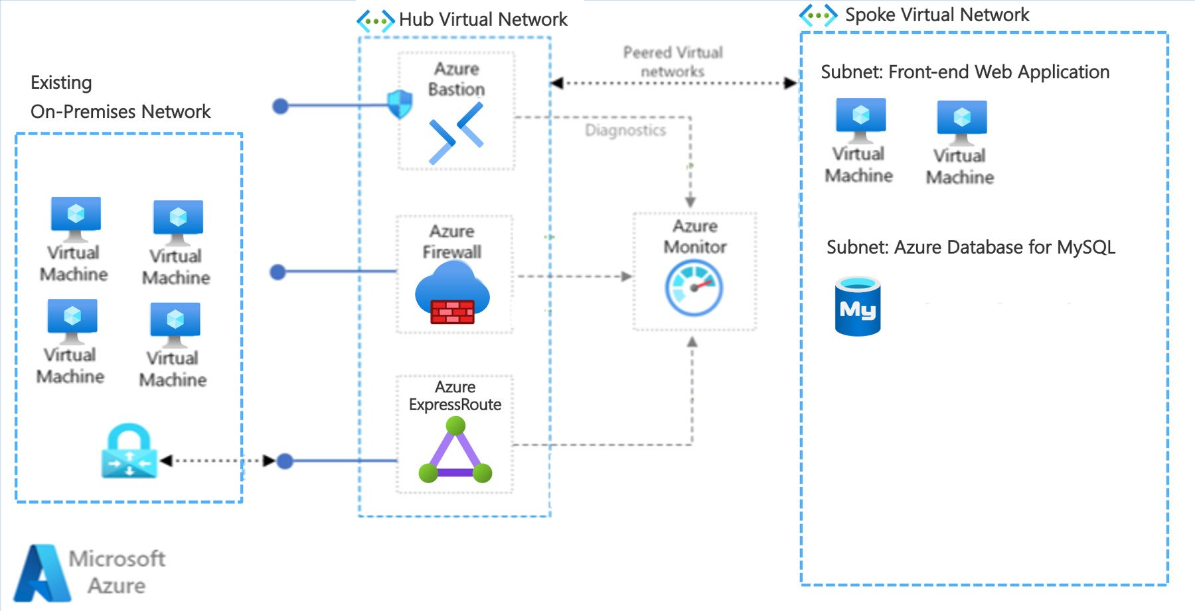
Preferred solution

Slide 14
Preferred solution
Main topic 1: size 36pt
Size 28pt for second level
Size 24pt for third level
Size 22pt for fourth level
Size 22pt for fifth level

Slide 15
Preferred objections handling
Main topic 1: size 36pt
Size 28pt for second level
Size 24pt for third level
Size 22pt for fourth level
Size 22pt for fifth level

Slide 16
Customer quote
Main topic 1: size 36pt
Size 28pt for second level
Size 24pt for third level
Size 22pt for fourth level
Size 22pt for fifth level

Slide 18
Text layout (without bullet points)
Main topic 1: size 36pt
Size 28pt for second level
Size 24pt for third level
Size 22pt for fourth level
Size 22 for fifth level

Slide 19
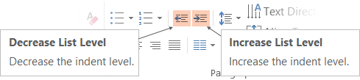
Text with bullet points - adjusting list levels
Main topic 1: size 36pt
Size 28pt for second level
Size 24pt for third level
Size 22pt for fourth level
Size 22 for fifth level
Use the “Decrease List Level” and “Increase List Level” tools on the Home Menu to change text levels.
Try this:
Place your cursor in any row of text to the left that says “Size 20pt for subtopics”
Next click the Home tab, and then on the “Decrease List level” tool. Notice how the line moves up one level.
Now try placing your cursor in one of the “Main topic…” lines of text. Click the “Increase List Level” tool and see how the text is pushed in one level
Use these 2 tools to adjust your text levels as you work

Slide 20
Bullet points layout with subtitle Subtitle is smaller in the same text block
Example of a bulleted slide with a subhead
Set the slide title to “Sentence case”
Set subheads to “Sentence case”
Hyperlink style
www.microsoft.com

Slide 21
Photo layout 1

Slide 22
Section title

Slide 23
Software code slide
This slide layout uses Consolas, a monotype font which is ideal for showing software code.

Slide 24
Notes (hidden)
Some speakers at Microsoft like to use this slide for hidden “notes slides”.
Delete it if you don’t want to use it.
NEXT: <next slide title>

